Slide 1
A Look at MySQL’s Conceptual Architecture
EECS4314: Advanced Software Engineering
Tabs vs. Spaces
Varsha Ragavendran
Nisha Sharma
Davood Anbarnam
Ayman Abualsunun
Anton Sitkovets
Glib Sitiugin
Kevin Arindaeng
Notes:
10 sec max

Slide 2
Introduction and Overview
Provides computations for query processing
Prominent features - Performance, Speed, and Reliability
Used in high-profile applications - Facebook, Google, Twitter, YouTube, etc.
Architecture
Concurrency Controls
Evolvability
External Interfaces
Use Cases
Conclusion
Notes:
1min: Varsha

Slide 3
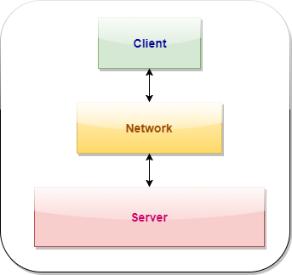
Architecture - Overview
At High Level, MySQL Database System operates via Client Server Architecture
Server:
Is the core program that manages database content
Handles Bulk of the computation
Client:
Connects to the Server Via Network to read, write or update data
Non-Client Utility Programs and Services include
File retrieval
Backup and Restore etc.
Figure 1. MySQL's Client-Server Architecture
Notes:
2min: Nisha

Slide 4
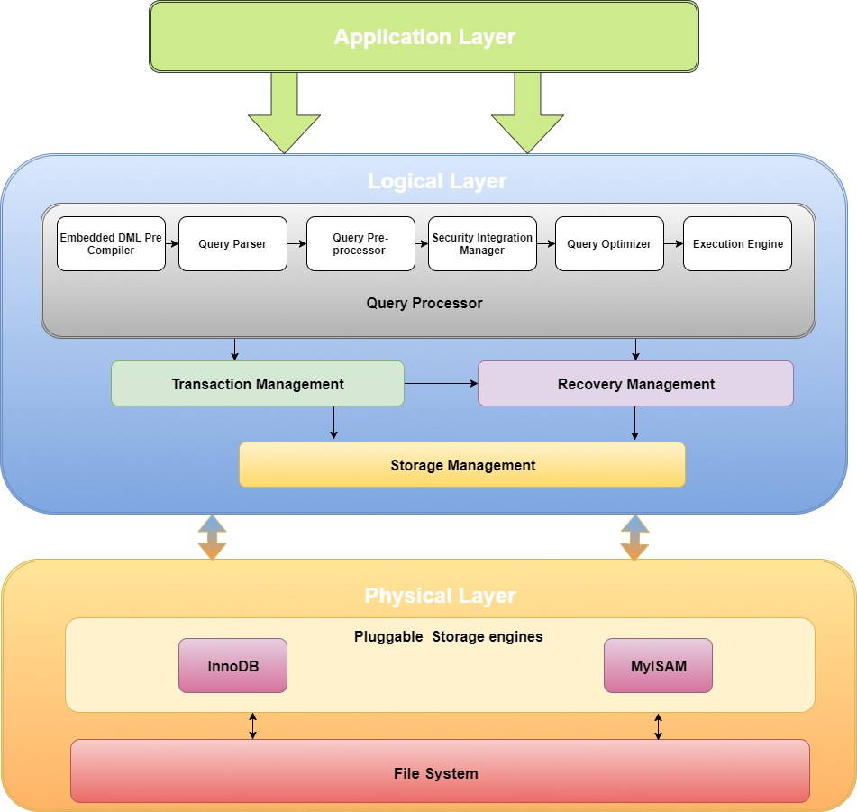
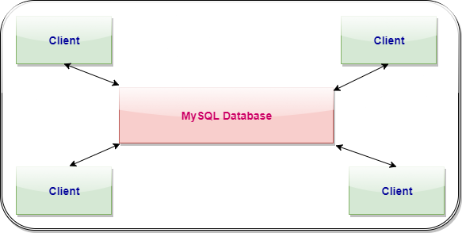
Architecture - Overview (Layered)
Figure 2. Repository Style Architecture
Notes:
Nisha

Slide 5
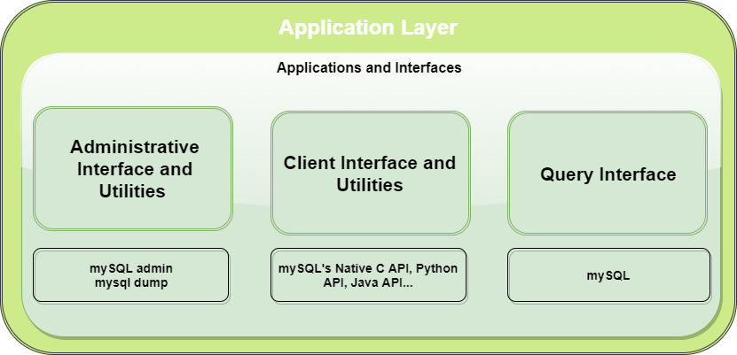
MySQL Layered Architecture
APPLICATION LAYER
RDBMS interacts with users and clients
Three components:
Administrators
Clients
Query Users
Notes:
(Nisha)
RDBMS interacts with users and clients
Three components:
Administrators
use various administrative interface and utilities like mysqladmin, isamchk etc.
Clients
Query Users
interaction via "mysql": a Query interface

Slide 6
MySQL Layered Architecture (Continued…)
Logical Layer:
Notes:
Nisha

Slide 7
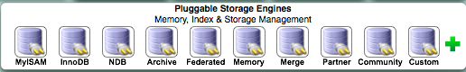
MySQL Layered Architecture (Continued…)
Physical Layer:
Notes:
Nisha

Slide 8
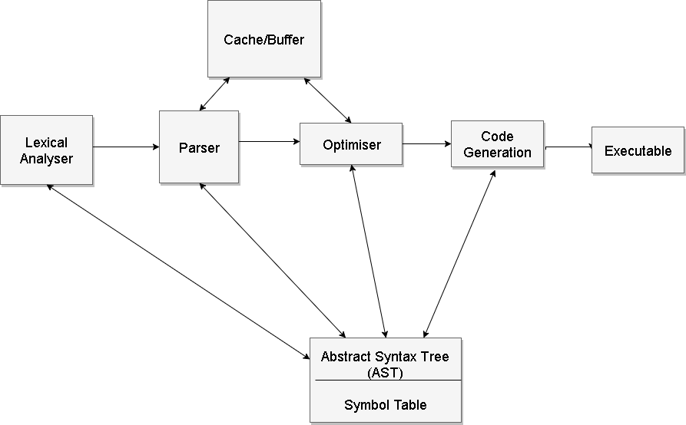
Architecture - Compilation
Lex/YACC
Syntax
Semantics
Optimising
Notes:
1.5min: Davood

Slide 9

Architecture - Optimizer
3 steps, SELECTION > PROJECTIONS > JOIN::EXECUTE
Notes:
1.5min: Ayman

Slide 10
Architecture - Query Cache & Buffers
Query Cache: Cache for frequently used queries, which caches the query and the results, as well as purging old data on updated data.
Table Cache: Memory cache for table metadata to reduce time for opening, reading and closing tables. Each thread has its own list of table cache structures allowing them to have their own views of tables.
Buffer Pool: Stores table and index data.
Record Cache: Cache for sequential reading of tables. Consists of a read ahead buffer that takes one block of data at a time.
Key Cache: Cache for frequently used index data. Implemented using a warm system to classify how frequently an index has been accessed over time (LRU).
Privilege Cache: Caches user privilege within system.
Notes:
1.5min: Anton

Slide 11
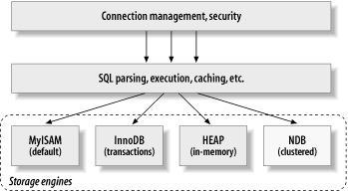
Architecture - Storage Engines
Responsible for the storage and retrieval of all stored data
Pluggability feature
Two commonly used engines - InnoDB and MyISAM
Notes:
1.5min: Varsha
Removed Parts: Other engines - MEMORY, BLACKHOLE, CSV, ARCHIVE, FEDERATED, MERGE, EXAMPLE, CUSTOM
Image is from:
http://books.gigatux.nl/mirror/highperfmysql/0596003064/hpmysql-CHP-2-SECT-1.html

Slide 12
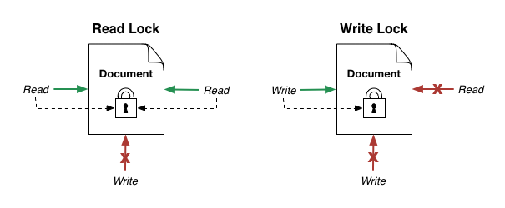
Concurrency Control: Lock Types
Read locks: mutually nonblocking locks. Many clients may read from a resource at the same time and not interfere with each other.
Write locks: exclusive locks. Write locks block both read locks and other write locks.
Notes:
1.5min: Glib

Slide 13
Concurrency Control: Lock Granularity
Table Lock: the most basic and low-overhead locking strategy available in MySQL.
Advantages: - Low memory requirements - Fast if you often do GROUP BY operations on a large part of the data - Fast if must scan the entire table frequently
Notes:
1.5min: Glib

Slide 14
Concurrency Control: Lock Granularity
Row locks offer more concurrency than table locks, but also carry a heavier overhead.
Advantages: - Fewer lock conflicts
InnoDB storage engine supports both table-level locking and row-level locking, while MyISAM only supports table locking.
InnoDB is more efficient when there is heavy write load.
Notes:
1.5min: Glib

Slide 15
Concurrency Control: Lock Granularity
Row locks offer more concurrency than table locks, but also carry a heavier overhead.
Advantages: - With row-level locking there are fewer lock conflicts when different sessions access different rows. As a result, it is possible to lock a single row for a long time.
Answer: InnoDB
Notes:
1.5min: Glib

Slide 16
Architecture - Transaction Processing System
Transactions are ATOMIC, all or nothing.
Required to pass the ACID test.
Different isolation levels.
Transactions logging.
Notes:
1.5min: Ayman

Slide 17
How does the system evolve
Abstraction between components supports evolvability
Future enhancements will not affect output
Notes:
30 sec: Varsha

Slide 18
External Interfaces
Connectors and APIs
Connector/J, Connector/C++, X DevAPI
Graphical User Interfaces
MySQL Workbench, Adminer, DBEdit
Notes:
1.5min: Kevin
In terms of external interfaces, we’re talking about how information is transferred to and from the system. So in this case, it would essentially be how users and developers interact with the MySQL database server, such as sending queries.
There are 2 main types: Connectors and APIs, and Graphical User Interfaces

Slide 19
Connectors and APIs
Common way to interact with MySQL Server, along with MySQL Shell
Supports general connectors with APIs for many languages (Java, C, C++, .NET)
Most connectors are based on the Open Database Connectivity (ODBC) model.
Notes:
Kevin
For Connectors and APIs, I would say that this is one of the most common way for developers to use MySQL. [Using the MySQL shell is also popular.]
You can develop apps using MySQL, or connect to MySQL with many general connectors for different languages. Here i listed the most common, such as Java, C, C++, Python.
For example, the connector for Java would be Connector/J
Most of the connectors are based on the ODBC model (Open Database Connectivity Model).

Slide 20
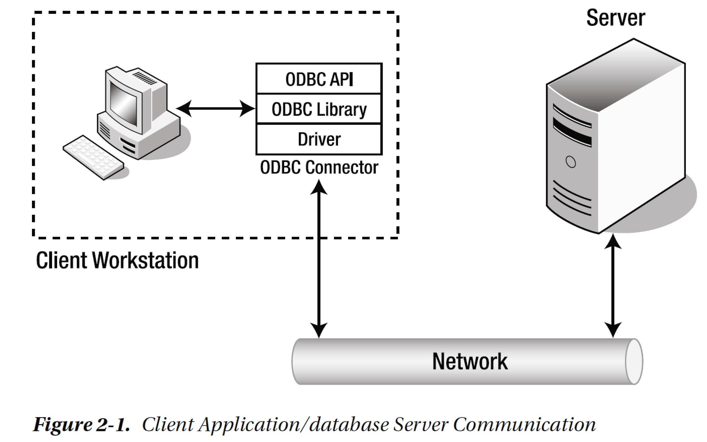
ODBC Low-level architecture
Bell, C. (2012). Expert MySQL. Berkeley, CA: Apress, p.28.
Notes:
Kevin
Low-level architecture diagram
ODBC is a specification for an API, designed to send queries to the MySQL server and retrieve the information back to the client.
An example workflow of this would be the client using C to send a query
When the client sends the query, it goes to the connector (so an implementation of this would be Connector/C for example)
The connector would use its ODBC API and library to translate the C code into a command that MySQL understands
It uses a specialized driver to send the command to the MySQL server via a network, and also return the result.

Slide 21
Graphical User Interfaces
Alternative to traditional connectors and APIs
Allow you to view and interact with a user’s database graphically
Official integrated environment is MySQL Workbench. Many other 3rd party options exist.
Notes:
Kevin
Another common external interface is through a GUI
Allows you to view and interact with a database graphically, through buttons and such
MySQL develops their own GUI called MySQL Workbench, but other 3rd party options exist.

Slide 22
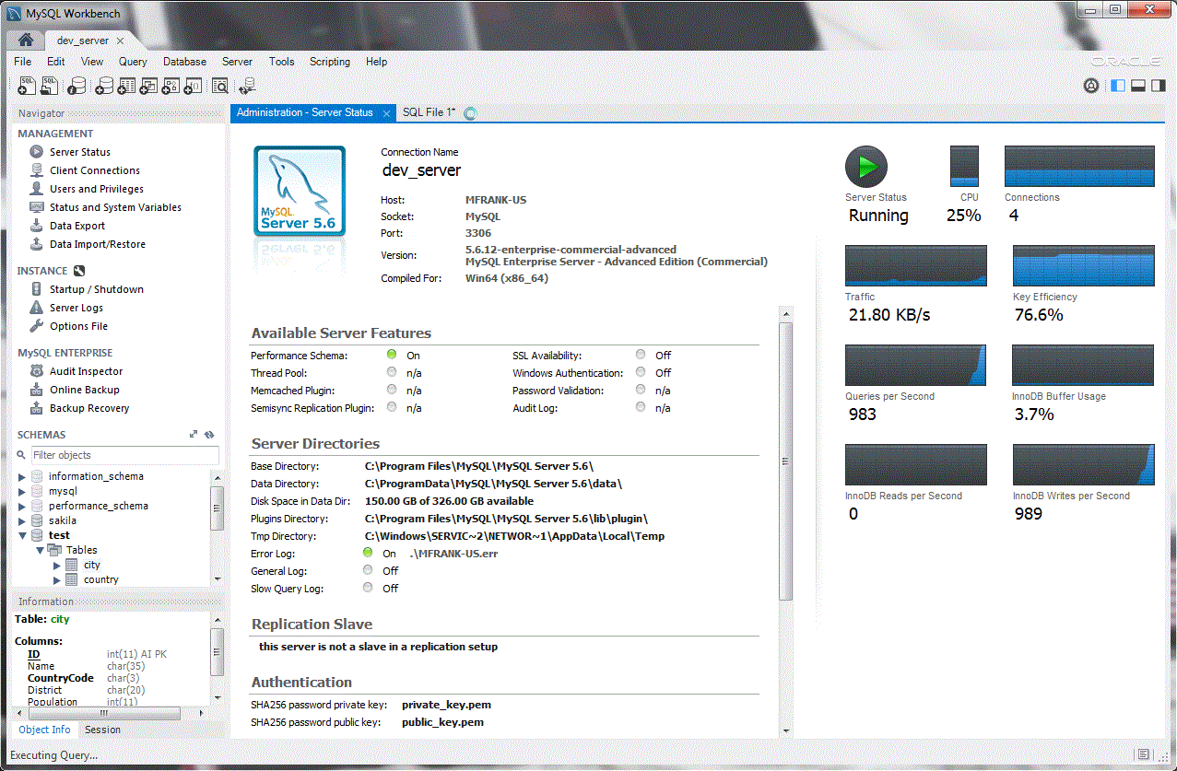
Notes:
Kevin
Here i just have a picture of MySQL Workbench, and highlighted some useful things you can do, such as query, export or import data, start or shutdown a server, etc.

Slide 23
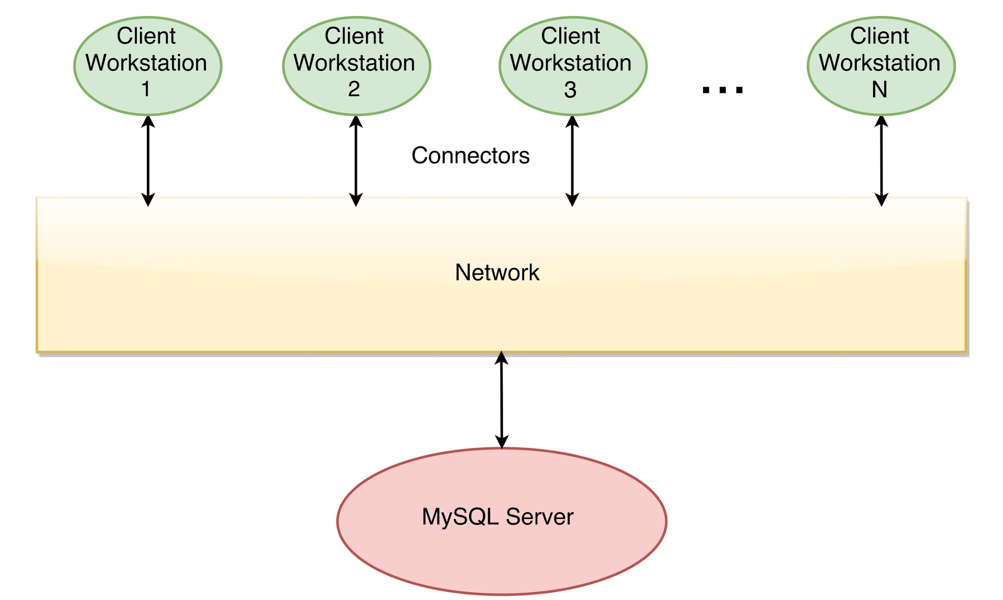
Client-Server Style
Repository Style
Notes:
Kevin
High-level diagram of the architecture of the two external interfaces i’ve spoken about:
The obvious architectural style that connectors and GUIs incorporate would be the client-server style. The reasoning behind this would be:
MySQL Server handles most of the data processing, whilst the clients do little, other than send commands.
Reason clients can connect to MySQL server is through connectors, which is a key feature of client-server.
The other being repository style
You could say that the central data structure would be MySQL server, and we would have several components (which would be the clients) that operate on it.
Another key feature of a repository style is concurrency, which MySQL Server also has.

Slide 24
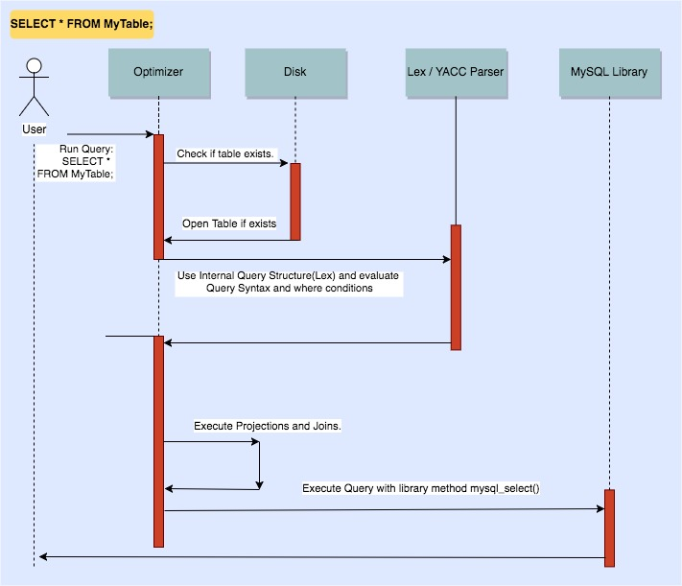
Use Cases
Notes:
2min: Anton

Slide 25
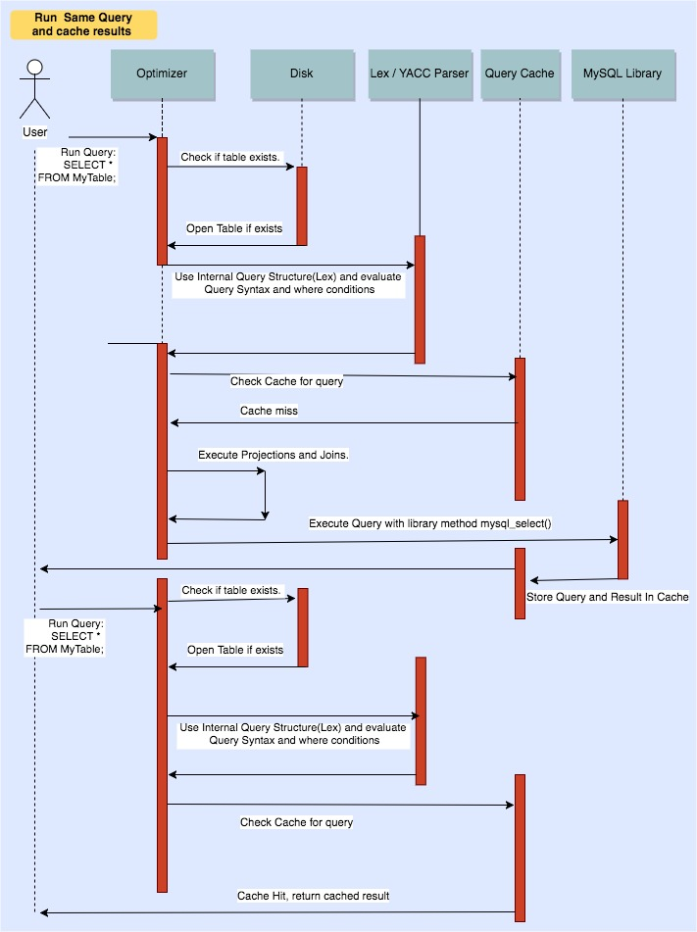
Notes:
Anton

Slide 26

Conclusions
Division of Responsibility
Storage Engines
Architecture Burrito
Notes:
1.5min: Davood

Slide 27

Lessons Learned
Notes:
1min: Davood + all
Kevin: MySQL has many ways for users and devs to interact with it. Include but not limited to connectors, APIs, GUIs, etc. Documentation is available and there’s good support.

Slide 28
Question Period

